Slide 1

Weather Station Project
Submitted by: Manish Kumar Yadav
M.Sc. IT - Part II, Semester III
Shailendra Degree College
Guide: Asst. Prof. Hemchandra Kumbhar
Seat Number : 1313603

Slide 2
Introduction
• This project aims to build a Weather Station using IoT.
• It captures temperature and humidity data using sensors.
• The data is visualized on a cloud platform.

Slide 3
Description of System
• Uses Arduino UNO as the microcontroller.
• DHT11 sensor captures humidity and temperature & LED Display.
• Data is sent to the cloud for remote access.

Slide 4
Limitations of Present System
• Slower processing time.
• Requires additional devices for operation.
• Complex programming for microcontrollers.

Slide 5
Proposed System & Advantages
• Low-cost and energy-efficient solution.
• Uses NodeMCU and cloud-based storage.
• Provides real-time weather monitoring.

Slide 6
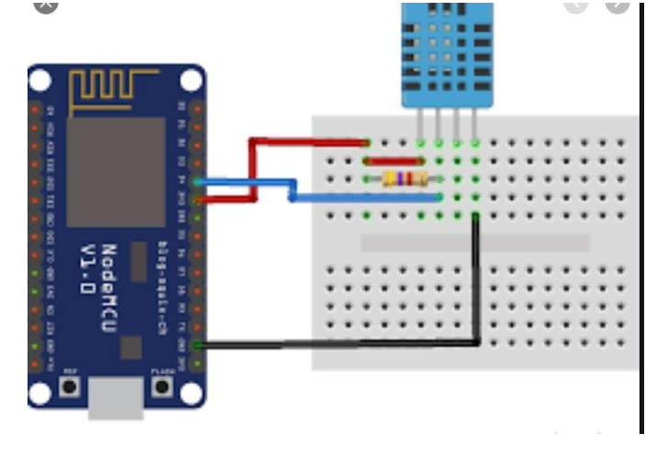
System Design & Implementation
• Hardware: NodeMCU, DHT11, Jumper Cables, Breadboard.
• Software: Arduino IDE, Thingspeak cloud platform.
• Circuit designed for accurate data capture.

Slide 7

Results & Data Visualization
• Test cases confirm system functionality.
• Data is exported in CSV format for analysis.
• Graphical visualization in Excel or Python.

Slide 8
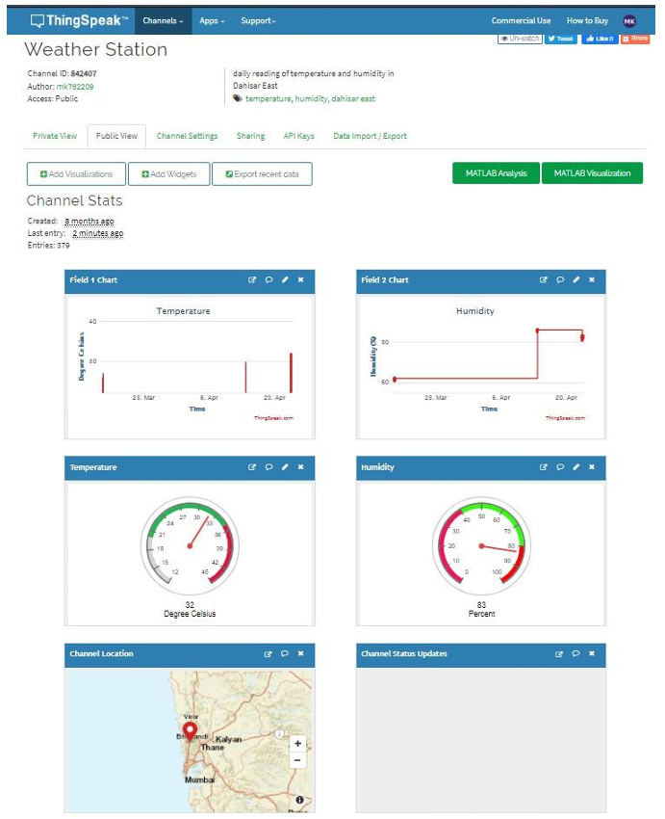

Slide 9
Future Enhancements & Conclusion
• Addition of sensors for air quality and wind speed.
• Integration with mobile apps for real-time alerts.
• Useful for farmers and environmental monitoring.

